Slide 1

Conservation science (196.315) Reserve selection
Jeffrey Hanson

Slide 2
Now
Biodiversity
Status quo
2000
Future

Slide 3
Now
How do we
bend the curve ?
Biodiversity
Status quo
2000
Future

Slide 4
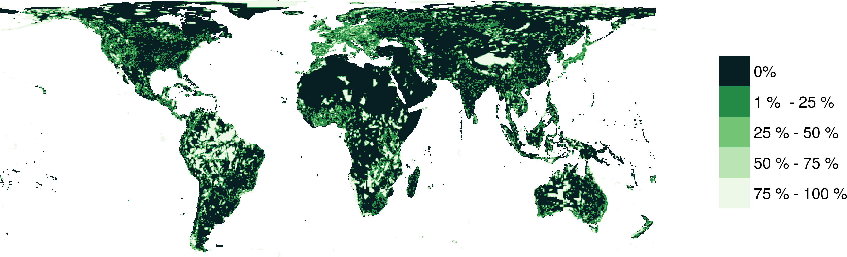
Protected areas

Slide 5



How do we bend the curve?
Ecological surveys
Distribution maps
Priority areas
Biodiversity
2000
Future
Data
Information
Plan
Outcome

Slide 6
How do we bend the curve?
Ecological surveys
Distribution maps
Priority areas
Biodiversity
2000
Future
Data
Information
Plan
Outcome
Prioritization

Slide 7
Reserve selection
Features
Notes:
- not all remaining habitat can be preserved
- achieve conservation objectives for minimal cost
- modern systematic conservation planning primarily focusses on representing species
- however, this ignores intra-specific biodiversity

Slide 8
Reserve selection
Planning
units

Slide 9
Reserve selection
?
?
?
?
?
?

Slide 10
Systematic conservation planning
“Systematic conservation planning aims to provide a rigorous, repeatable, and structured approach for designing new protected areas that efficiently meet conservation objectives”
Schuster et al. (2020) PeerJ, DOI:10.7717/peerj.9258

Slide 11

CARE Principles
Comprehensive
Adequate
Representative
Efficient
Kukkala & Moilanen (2013) Biol Rev, doi:10.1111/brv.12008

Slide 12

CARE Principles
Comprehensive
Adequate
Representative
Efficient
versus

Slide 13
CARE Principles
Comprehensive
Adequate
Representative
Efficient
versus

Slide 14
CARE Principles
Comprehensive
Adequate
Representative
Efficient
versus

Slide 15
CARE Principles
Comprehensive
Adequate
Representative
Efficient
versus

Slide 16
Connectivity
“improve population resilience to disturbance, increase metapopulation viability, promote genetic diversity and maintain energetic pathways among ecosystems”
Within-reserve connectivity
Daigle et al. (2020) Methods Ecol Evol, DOI:10.1111/2041-210X.13349

Slide 17
Connectivity
“improve population resilience to disturbance, increase metapopulation viability, promote genetic diversity and maintain energetic pathways among ecosystems”
Between-reserve connectivity
Highway
Daigle et al. (2020) Methods Ecol Evol, DOI:10.1111/2041-210X.13349

Slide 18
Principle complementarity
Protected areas should “complement” each other to maximize the performance of the overall protected area network (including. existing protected areas)
Vane-Wright et al. (1991) Biol Cons, DOI:10.1016/0006-3207(91)90030-D

Slide 19
Reserve selection
?
?
?
?
?
?

Slide 20
Reserve selection

Slide 21

But why?
Comprehensive
Adequate*
Representative**
Efficient
Connectivity***
Principle complementarity
*Assuming each species only needs 1 cell
***Assuming species can disperse
throughout entire landscape
**Assuming no significant intra-specific variation

Slide 22
Representation targets
Policy
“In 1992, the Fourth World Congress on National Parks and Protected Areas [recommended] “that protected areas cover at least 10 percent of each biome by the year 2000” (McNeely 1993).”
“[Aichi target 11] […] targets mandate that 17% of terrestrial areas, and 10% of coastal and marine areas should be covered by nature conservation networks […]”
Policy
“We set as a fixed target the conservation of at least 10% of grid cells occupied by a species, with a minimum of one.”
“As a habitat-specific target, we used 17% of the total number of PUs where the respective habitat occurs, adopting Aichi target 11 “
Targets
Friedrichs et al. (2018) Plos ONE, DOI:10.1371/journal.pone.0208264
Jetz et al. (2014) Current Biol, DOI:10.1016/j.cub.2014.03.011
Brooks et al. (2004) BioScience, DOI:10.1641/0006-3568(2004)054[1081:CPBTGP]2.0.CO;2

Slide 23
Representation targets
Statistical estimates/models
“We modelled […] scenarios based on […] the [population viability analysis] by Todd et al. (2016). The reserve scenarios were based on the protected area required to achieve a less than 5% chance of the Leadbeater’s Possum population falling to (or below) 500 or fewer adult females in 40 generations […]. [The worst case scenario] required the Leadbeater’s Possum reserve to be expanded to 171,345 ha.”
“We aimed to include 30% of each biodiversity feature [e.g. vegetation types, environmental domains, species distributions] while minimizing the economic cost of the system of selected areas. We set conservation targets for each feature at 30% of their pre-clearing (year 1770) extent to be consistent with international recommendations (IUCN, 2003) and to ensure that biodiversity features are represented in proportion to their natural extent”
Klein et al. (2009) Biol Cons, DOI:10.1016/j.biocon.2009.01.035
Taylor et al. (2017) Plos ONE, DOI:10.1371/journal.pone.0169629

Slide 24
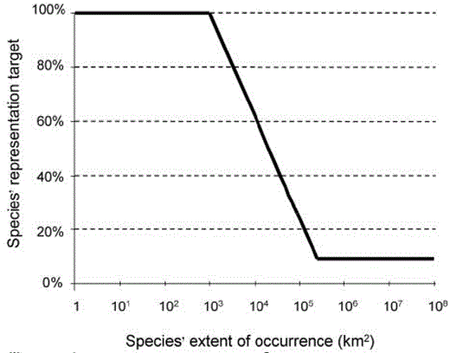
Representation targets
Expert thresholds
“Species into as many biodiversity features as the biomes in which the species occurs. We set species targets to conserving the minimum amount of species’ habitat necessary to qualify it for the conservation status ‘Least Concern’ following IUCN Red List criteria”
Jung et al. (2021) Nat Ecol Evol DO:10.1038/s41559-021-01528-7
Rodrigues et al. (2004), BioSicence, DOI:
10.1641/0006-568(2004)054[1092:GGAPRF]2.0.CO;2

Slide 25
Framing conservation as a decision science problem
Goal: what is our vision for the future?
Objective: what quantity are we maximizing/minimizing to achieve the goal?
Constraints: what must things must we account for when implementing different actions?
Decisions: what actions can we implement to achieve our objective?

Slide 26
Framing conservation as a decision science problem
Goal: what is our vision for the future?
Objective: what quantity are we maximizing/minimizing to achieve the goal?
Constraints: what must things must we account for when implementing different actions?
Decisions: what actions can we implement to achieve our objective?

Slide 27




Reserve selection as optimization
Goal: conserve biodiversity
Objective: min. # of islands
Constraints: sufficient habitat for each species (≥ 1 island per species)
Decisions: create a reserve on an island or not?

Slide 28
Reserve selection as optimization
Goal: conserve biodiversity
Objective: min. # of islands
Constraints: sufficient habitat for each species (≥ 1 island per species)
Decisions: create a reserve on an island or not?

Slide 29
But what are the top priorities?
Irreplaceability
“[…] continuum of values between 0 and 1, where sites with values of 1 are essential for achieving one or more targets and are therefore irreplaceable.”
Carwardine etl al. (2007) Biodivers Conserv, DOI:10.1007/s10531-006-9055-4

Slide 30

But where do we start?
Vulnerability
“[…] measure of the likelihood of the biodiversity in an area being lost to current or threatening processes”
Kukkala & Moilanen (2013) Biol Rev, doi:10.1111/brv.12008

Slide 31
But what are the top priorities?
Replacement cost
“[…] loss in solution value given that the optimal cost-efficient solution cannot be protected and alternative solutions, with particular sites forcibly included or excluded, are needed”
Carbeza & Moilanen (2006) Biol Cons, DOI:10.1016/j.biocon.2006.04.025

Slide 32
But what are the top priorities?
Replacement cost
Alternate solution 1:
1 extra island needed
“[…] loss in solution value given that the optimal cost-efficient solution cannot be protected and alternative solutions, with particular sites forcibly included or excluded, are needed”
Carbeza & Moilanen (2006) Biol Cons, DOI:10.1016/j.biocon.2006.04.025

Slide 33
But what are the top priorities?
Replacement cost
Alternate solution 2:
1 extra island needed
“[…] loss in solution value given that the optimal cost-efficient solution cannot be protected and alternative solutions, with particular sites forcibly included or excluded, are needed”
Carbeza & Moilanen (2006) Biol Cons, DOI:10.1016/j.biocon.2006.04.025

Slide 34
But what are the top priorities?
Replacement cost
It’s a tie?
“[…] loss in solution value given that the optimal cost-efficient solution cannot be protected and alternative solutions, with particular sites forcibly included or excluded, are needed”
Carbeza & Moilanen (2006) Biol Cons, DOI:10.1016/j.biocon.2006.04.025

Slide 35
But what are the top priorities?
Replacement cost
$$$
Different from irreplaceability because it accounts for lost efficiency, so priorities change if we wanted to minimize total cost (instead of just number of islands)
$$$
$$
$
$
$
$
$
$
Carbeza & Moilanen (2006) Biol Cons, DOI:10.1016/j.biocon.2006.04.025

Slide 36
But what are the top priorities?
Replacement cost
$$
$$
Different from irreplaceability because it accounts for lost efficiency, so priorities change if we wanted to minimize total cost (instead of just number of islands)
$$$
$$
$
$
$
$
$
$
$
Carbeza & Moilanen (2006) Biol Cons, DOI:10.1016/j.biocon.2006.04.025

Slide 37



Decision support tools
Zonation
Marxan
Prioritizr
Best suited for budget-limited problems
Heuristic algorithm
Trade-off curves for different species
Lots of built-in ways to handle connectivity
www.github.com/cbig/zonation-core/releases
Best suited for minimum set problems
Simulated annealing algorithm
Representation targets for different species
Generates portfolios of solutions
www.marxansolutions.org
Best suited for both problem types
Exact algorithms
Representation targets for different species
Extremely customizable
R package
www.prioritizr.net

Slide 38
So, what research have I done on reserve selection?
Hanson et al. (2020) Nature, DOI:10.1038/s41586-020-2138-7

Slide 39
Remember the CARE principles?
Comprehensive
Adequate
Representative
Efficient
versus

Slide 40
Evolutionary processes
Species range
Population

Slide 41
Evolutionary processes
Species range
Population

Slide 42
Evolutionary processes
Species range
Population

Slide 43
Species data
9,670 bird, 5,070 mammal, 5,197 amphibian species
5 × 5 km maps delineating suitable habitat
Split each species’ distribution into 10 “environmental” partitions
Habitat targets set following Rodrigues approach

Slide 44
Italian Agile Frog

Slide 45
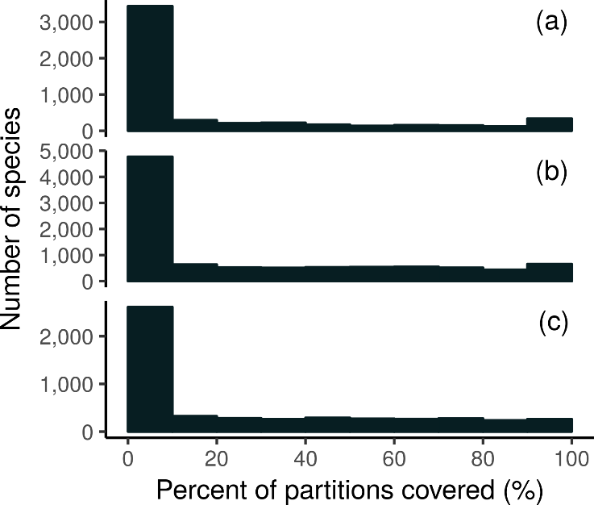
How good is the existing protected system?
Amphibians
18,688 (94%) species are not adequately represented in reserves
8,921 (45%) species do not have a single partition adequately represented
Of these 8,921 species, 2,266 species are globally imperilled
Birds
Mammals

Slide 46
Giant Panda
Local adaptations
in immune system

Slide 47
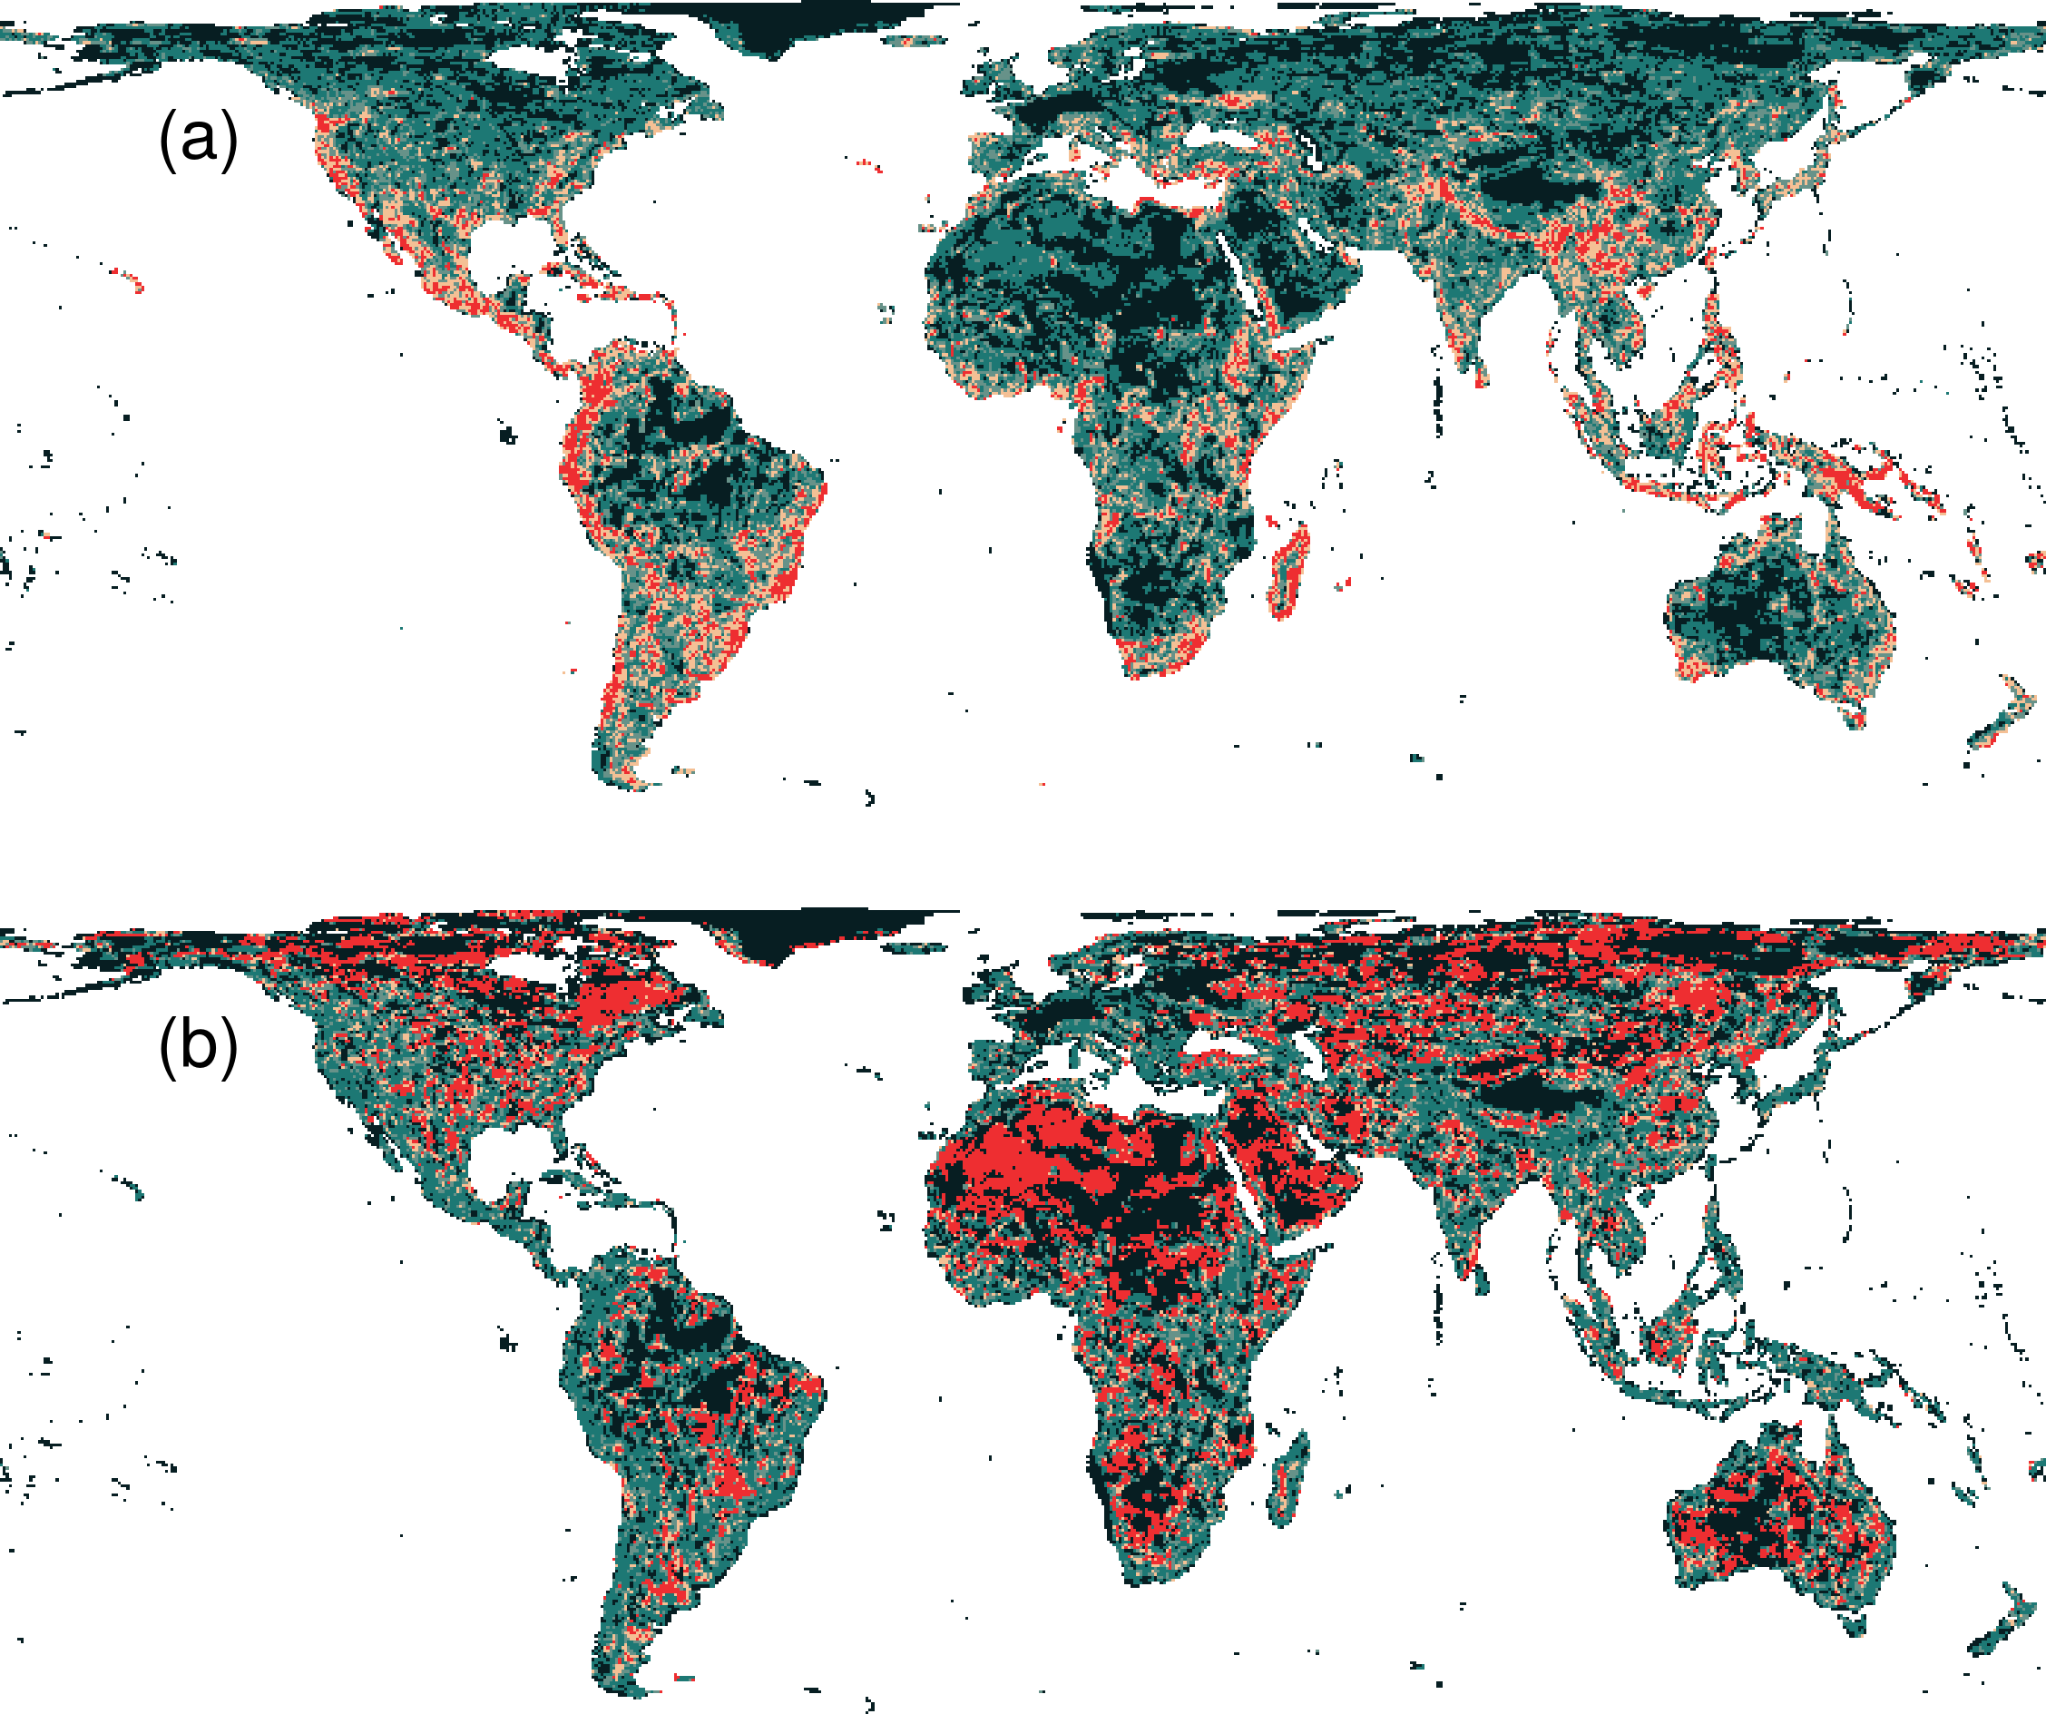
Prioritization for realized niches
35.9 % of the Earth’s land needed to complement existing protected areas
Biodiversity hotspots are critically important
Conservation efforts needed across the planet

Slide 48
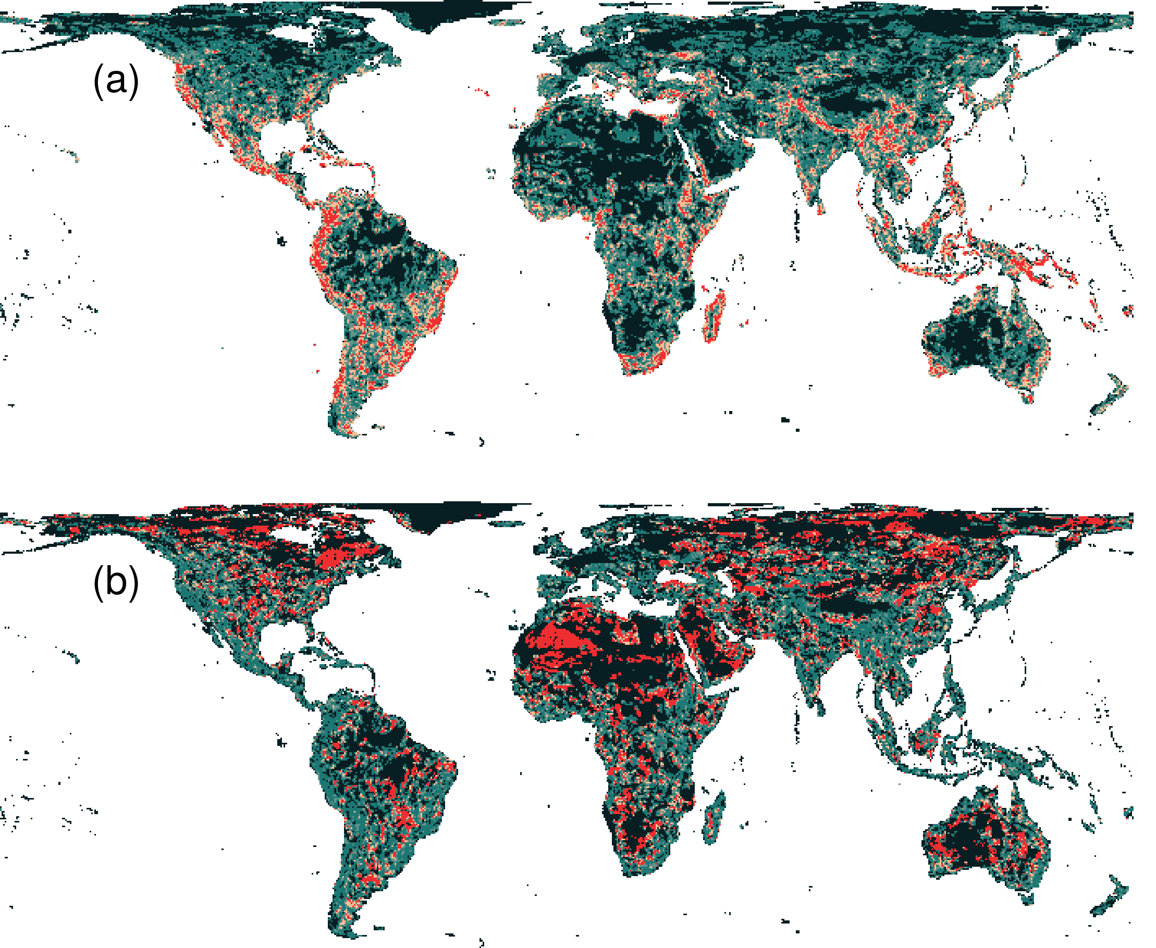
What if we ignore species niches?
Only 3.7% less of the Earth’s land than prioritization which considers niches
Fails to adequately represent 7,989 (40%) species

Slide 49
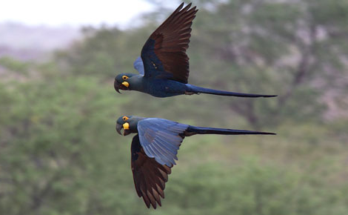
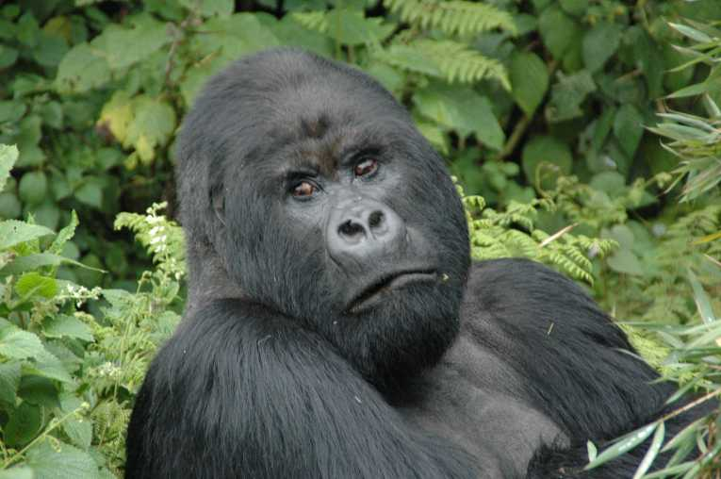
Conservation of realized niches
Current protected area system is insufficient
More protected areas are needed to fill the gaps
Future conservation efforts need to explicitly account for environmental variation

Slide 50

Thanks for listening!

